Slide 1



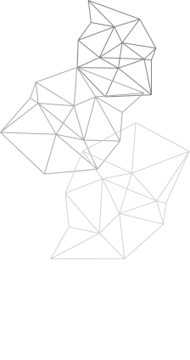

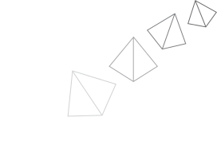



Traximo
#MoveToPlay
Team Name: Titans
Challenge: Open Innovation
Team Members
Ujjwal | Sumit Saini | Urvashi Choubey

Slide 2







Problem Nowadays
Nowdays , gaming is an extremely popular leisure-time activity with large userbase worldwide.
This skyrocketing popularity of the gaming culture has given rise to several problems :
Short eye-screen distance
Decline in physical activities
Increase in posture defects

Slide 3

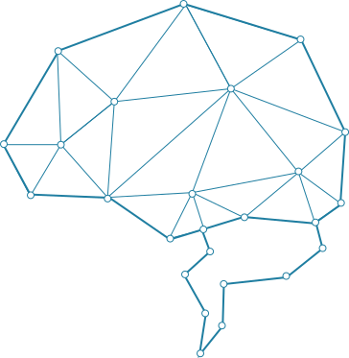

Our Idea
Traximo is a collection of #MoveToPlay games which encourages physical activities to play digital games. It increases engagement and interaction and provides a richer user experience. All of this is achieved through motion detection only using webcams installed in our devices. Our goal is to blend the immersiveness of virtual world with the active movements of physical world without any expensive devices.

Slide 4



We Are Here To Bring
You The Solutions
Motion Detection using Computer Vision
Action based
interface
Various edge & motion detection algorithms are used to detect user movements and actions.
The player interacts with the virtual world by doing physical actions like waving their arms or jumping or ducking. This increases physical activity of the gamer and makes the game more immersive and fun.

Slide 5
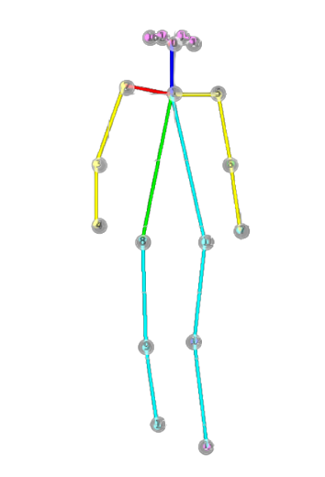
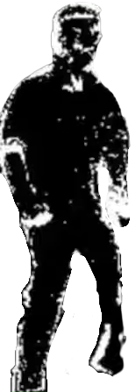


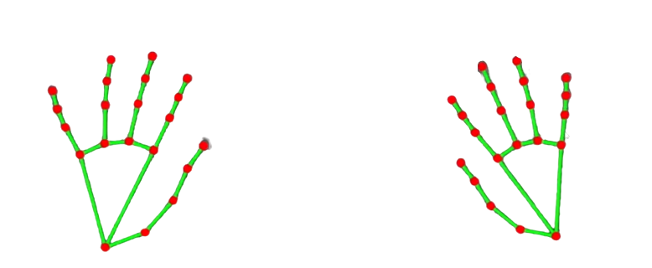



Competitive Advantage
Compact
Immersive
Traximo doesn't require any external device.
Motion will be captured using the webcam of the device.
Traximo is an immersive environment where the user has to do physical activities to interact with the system instead of just swingging fingers on the device.
Compatable
Feasible
Traximo is a web-app, hence, it is cross-platform and can be used in any device with webcam.
Traximo is a free to play arcade centre that only needs good internet connection and a device with a webcam.

Slide 6

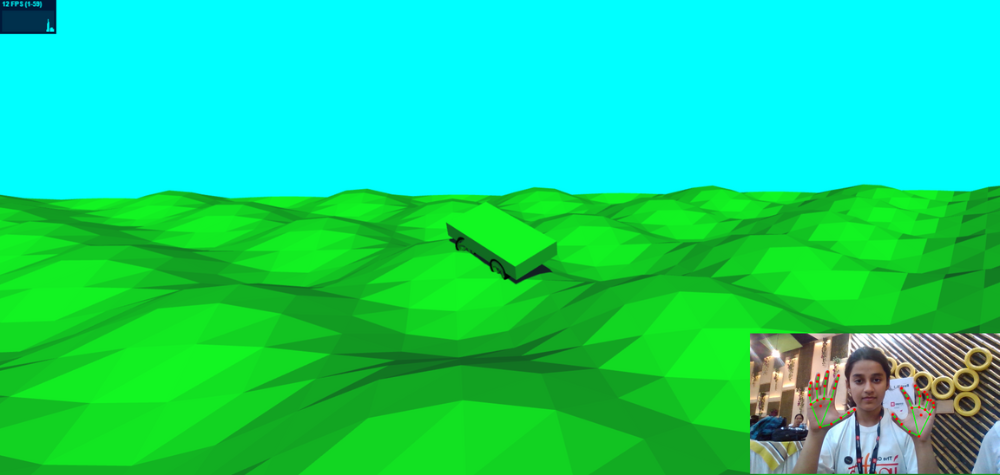
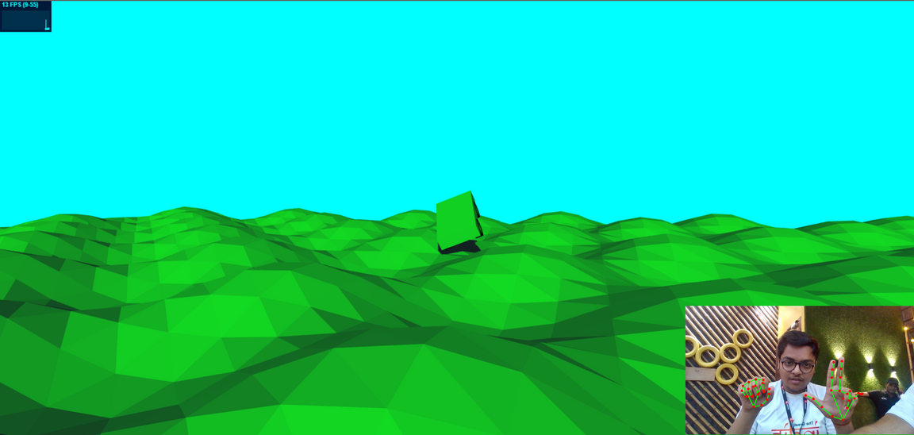
Implemented Models
3d Car Simulation
3d Car Simulation where car's controls are mapped to various hand gestures provided with an immersive webGL experience.
Test Now

Slide 7
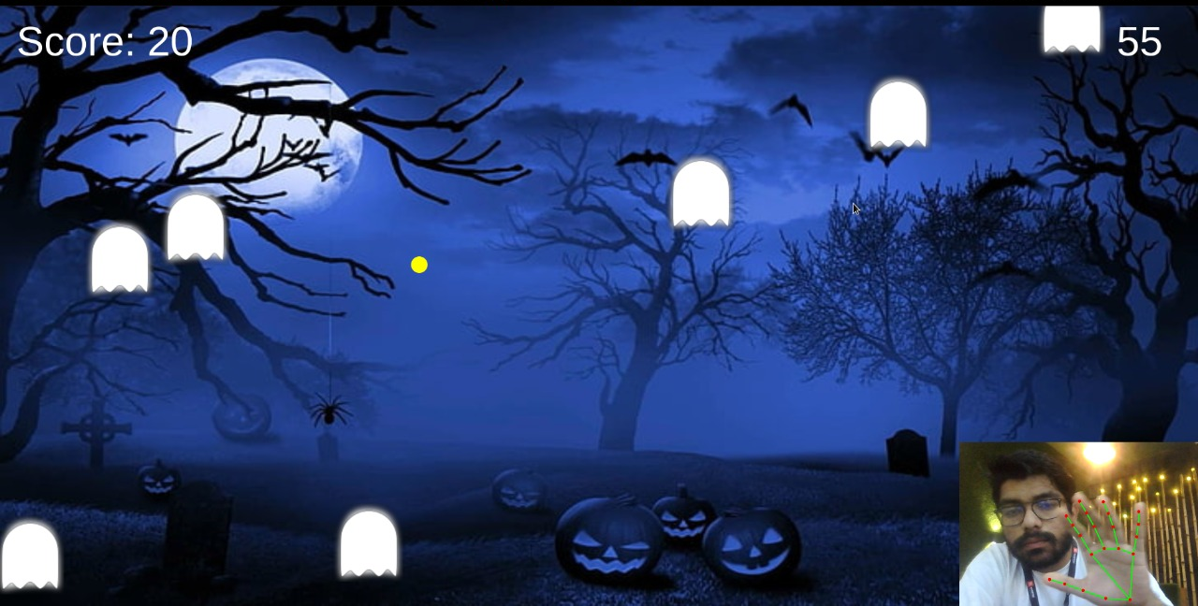

Implemented Models
Ghosts Hunter
Test Now

Slide 8

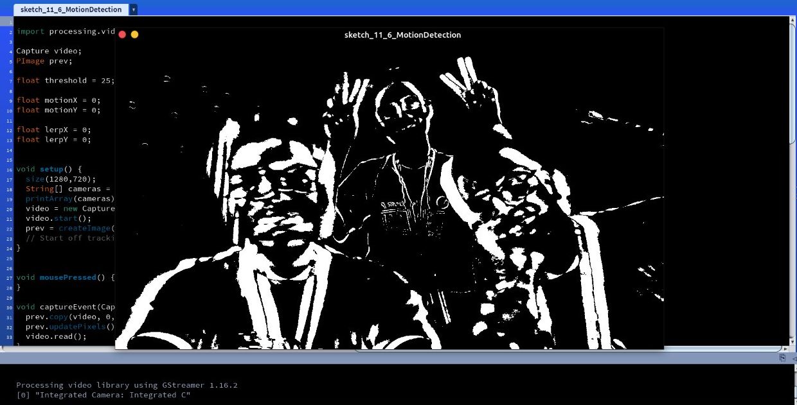
Implemented Models
Red Light Green Light
using
Motion Detection*
*will be completed soon

Slide 9


Hosted on MS Azure
Our website is hosted with all games combined in a web-based arcade center and you can enjoy them and test them right now!!
Check Here

Slide 10

Future Scope
On commercial implementation, this solution can open this move to play genre to a whole new audience.

Slide 11


THANK YOU !!!

